Slide 1
In this project,
I created a weather API based on weather measurements and weather station data in Hawaii that were provided in CSV files.
I used the Jupyter Notebook for most of my work on this API.
The first step was the data engineering step. In this step, I inspected the data inside the CSV files to see if it needed to be cleaned.
I did this by reading the CSV files with pandas.
When I inspected the data frame I created I saw that the data from the CSV file containing the weather measurements had a considerable amount of “NaN” values in the precipitation column. I chose to leave the “NaN” values in because I didn’t want to make assumptions about the data.
The next step in the process was database engineering. In this step, I created the SQLite database for my weather API. I used pandas and SQLAlchemy and the CSV files that I was provided to create my SQLite database.
https://github.com/ENPlummer/Surfs_UP/blob/master/database_engineering.ipynb
The third step in creating my weather API was to do a climate analysis based on the data that was stored in the SQLite database that I created. In this step, I analyzed the data using SQLAlchemy to do queries on the data. I then used Pandas to create data frames so I could create graphs using Matplotlib.
The final step was to create a Flask app to power my weather API. I exported my climate analysis Jupyter Notebook as a Python file. I then added the required Flask routes so the app would run.

Slide 2
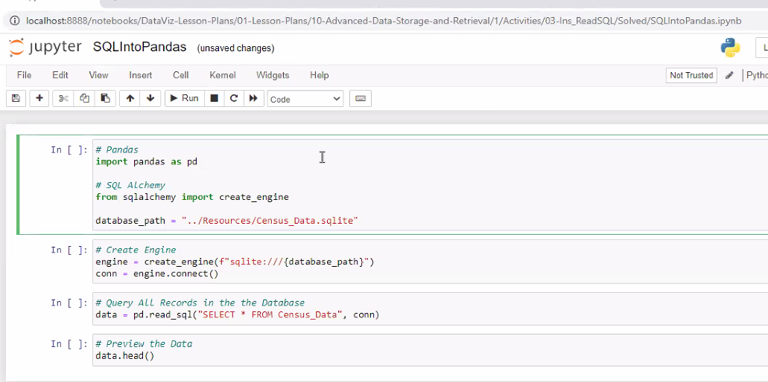



Slide 3
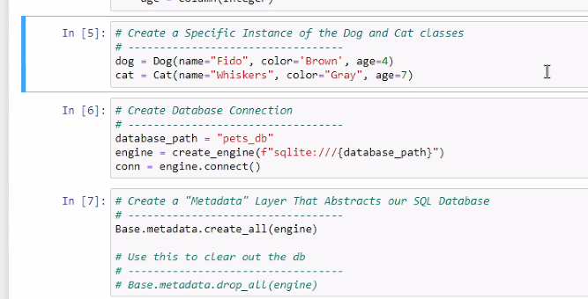
Es el metadata necesario para update la DB?. DROP TODOS LOS REGISTROS

Slide 4
https://stackoverflow.com/questions/31997859/bulk-insert-a-pandas-dataframe-using-sqlalchemy
from urllib import quote_plus as urlquote
import sqlalchemy
from sqlalchemy import create_engine
from sqlalchemy.ext.declarative import declarative_base
from sqlalchemy import Column, Integer, String, Numeric
from sqlalchemy.orm import sessionmaker
import pandas as pd
# Set up of the engine to connect to the database
# the urlquote is used for passing the password which might contain special characters such as "/"
engine = create_engine('mysql://root:%s@localhost/db1' % urlquote('weirdPassword*withsp€cialcharacters'), echo=False)
conn = engine.connect()
Base = declarative_base()
#Declaration of the class in order to write into the database. This structure is standard and should align with SQLAlchemy's doc.
class Current(Base):
__tablename__ = 'tableName'
id = Column(Integer, primary_key=True)
Date = Column(String(500))
Type = Column(String(500))
Value = Column(Numeric())
def __repr__(self):
return "(id='%s', Date='%s', Type='%s', Value='%s')" % (self.id, self.Date, self.Type, self.Value)
# Set up of the table in db and the file to import
fileToRead = 'file.csv'
tableToWriteTo = 'tableName'
# Panda to create a lovely dataframe
df_to_be_written = pd.read_csv(fileToRead)
# The orient='records' is the key of this, it allows to align with the format mentioned in the doc to insert in bulks.
listToWrite = df_to_be_written.to_dict(orient='records')
metadata = sqlalchemy.schema.MetaData(bind=engine,reflect=True)
table = sqlalchemy.Table(tableToWriteTo, metadata, autoload=True)
# Open the session
Session = sessionmaker(bind=engine)
session = Session()
# Inser the dataframe into the database in one bulk
conn.execute(table.insert(), listToWrite)
# Commit the changes
session.commit()
# Close the session
session.close()

Slide 5
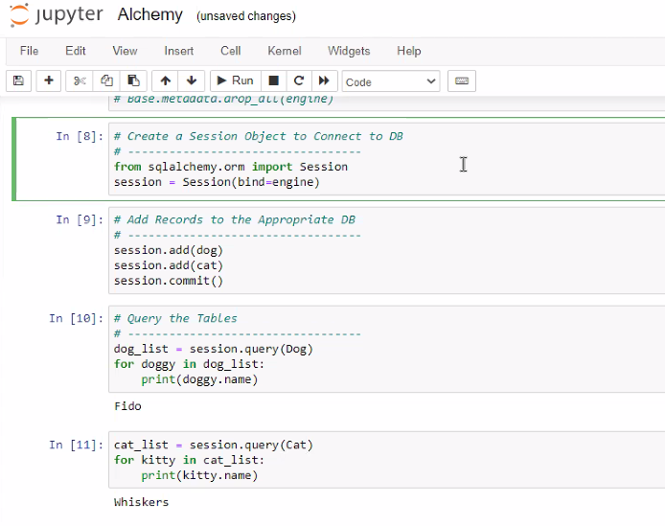


Slide 6
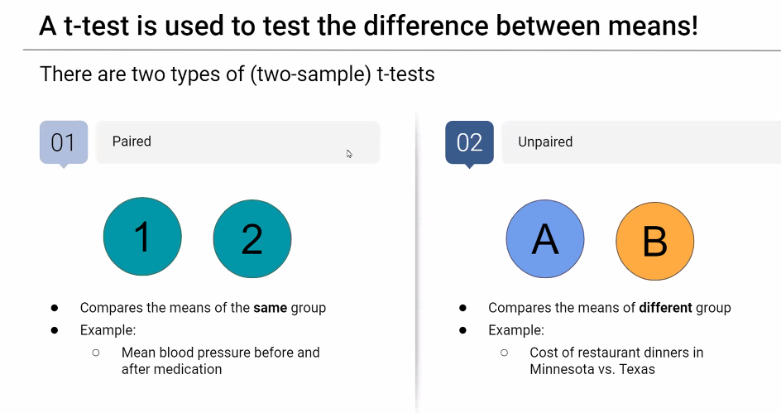


Slide 7
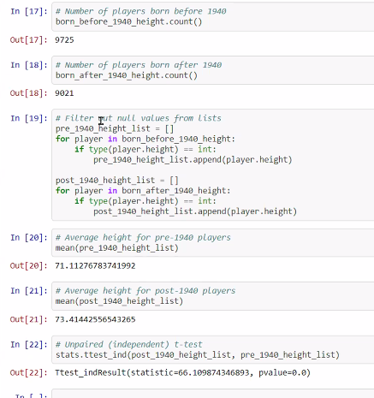
T-test

